Slide 1
Introduction to Computing
Lecture 01

Slide 2
Text book
Introduction to Computers 6th International Edition, Peter, N. McGraw-Hill ISBN-13:978-0078210587

Slide 3
Overview
Computer and Computer system
Computer Organization
What is IT?
Computer technology
Communications technology
Role of IT in society
Software

Slide 4
Computer System
A complete, working computer along with softwares and peripheral devices that are necessary to make the computer function is called Computer system. Every computer system requires an operating system to operate.

Slide 5
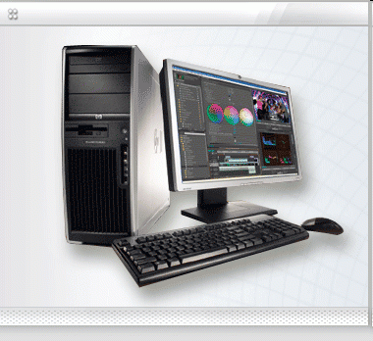
Computer System

Slide 6
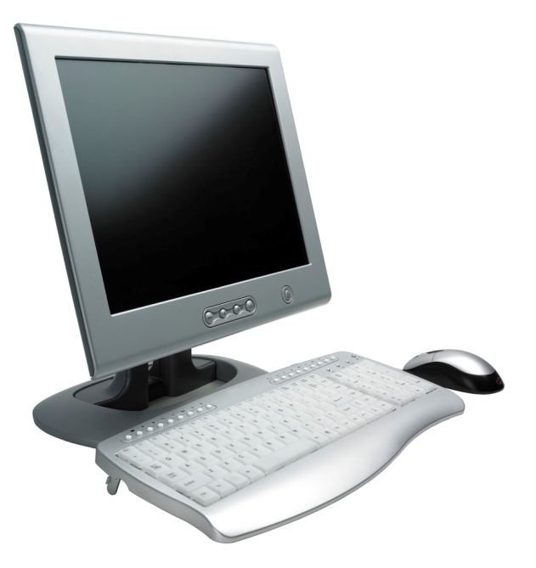
What is a Computer?
An electronic machine that can accept data (input), manipulate the data according to specified rules (process), produce results (output), and stores the results for future use.

Slide 7
The Components of a Computer
Input devices
Output devices
System Unit/ CPU
Storage devices
Communications devices

Slide 8
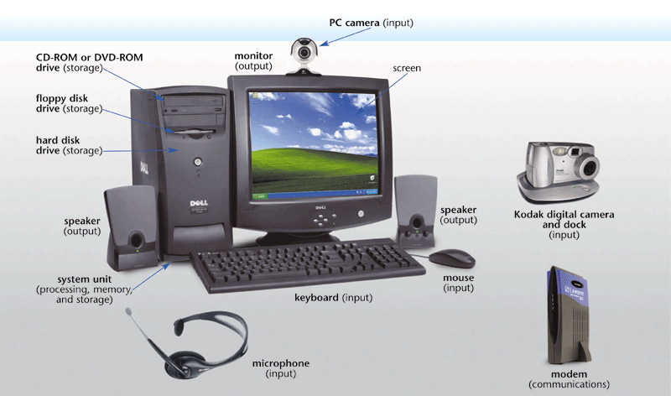
The Components of a Computer

Slide 9
What is IT?
Information technology (IT) is a general term that describes any technology that helps to produce, manipulate, store, communicate, and/or disseminate information.
IT merges computing with high-speed communications links carrying data, sound, and video.
Examples of information technology include personal computers but also new forms of telephones, televisions, appliances, and various handheld devices.

Slide 10
Parts of IT
Computer technology
Communications technology

Slide 11
Computer Technology
A computer is a programmable, multiuse machine that accepts data (raw facts and figures) and processes, or manipulates, it into information we can use, such as summaries, totals, or reports.
Its purpose is to speed up problem solving and increase productivity.

Slide 12
Communications Technology
Communications technology, also called telecommunications technology, consists of electromagnetic devices and systems for communicating over long distances.
The principal examples are telephone, radio, broadcast television, and cable TV.
A network is a communications system connecting two or more computers; the internet is the largest such network.

Slide 13
Role of IT in Society
Education
Health
Money
Leisure(Entertainment)
Job and career

Slide 14
Role of IT in Education
When properly integrated into the curriculum and classroom, information technology can allow students to personalize their education
Automate many tedious and rote tasks of teaching and managing classes;
Reduce the teacher’s workload per student, so that he or she can spend more time on reaching individual students.
Course-management software is used for administering online assignments, schedules, examinations, and grades.
Email is one good use in education.

Slide 15
Role of IT in Health
Computer technology is radically changing the tools of medicine.
All medical information, including that generated by X ray, lab test, and pulse monitor, can now be transmitted to a doctor in digital format.
Image transfer technology allows radiologic images such as CT scans and MRIs to be immediately transmitted to electronic charts and physicians’ offices.
Patients in intensive care, who are usually monitored by nurses during off-times, can also be watched over by doctors in remote “control towers” miles away.

Slide 16
Role of IT in Money
The future of money is increasingly digital, likely virtual, and possibly universal.
“Virtual” means that something is created, simulated, or carried on by means of a computer or a computer network.
Billing can be done online.
Some banks and other businesses are backing an electronic-payment system that allows internet users to buy goods and services with micropayments.

Slide 17
Role of IT in Leisure Activities
Information technology is being used for all kinds of entertainment, ranging from videogames to telegambling.
It is also being used in the arts, from painting to photography.
A user can offer songs online free for downloading (transferring data from a remote computer to one’s own computer) so that people could listen to them before paying $12 for a CD.
It also puts videos online for sharing and uses quirky websites to reach fans.
Through animation computers are revolutionizing movies.

Slide 18
Role of IT in Jobs & Careers
In the hotel business, even front-desk clerks need to know how to deal with computerized reservation systems.
In law enforcement, police officers need to know how to use computers while on patrol or at their desks to check out stolen cars, criminal records, outstanding arrest warrants, and the like.
In entertainment, computers are used for such ordinary purposes as budgets, payroll, and ticketing.
However, there are also new careers in virtual set design, combining training in architecture and 3-D computer modeling, and in creating cinematic special effects.
Computers can be used both for you to find employers and for employers to find you.

Slide 19
Categories of Computers
Super Computer
Computers that have the most capable processing power of its time
Mainframe Computer
Mostly used by corporations, government agencies, and banks
Mini Computer
Multiprocessing machine that can support up to about 200 users at the same time
Micro Computer
Smaller computers that run on microprocessors in their central processing units
Mobile Computer
Computers that are super small and mobile

Slide 20
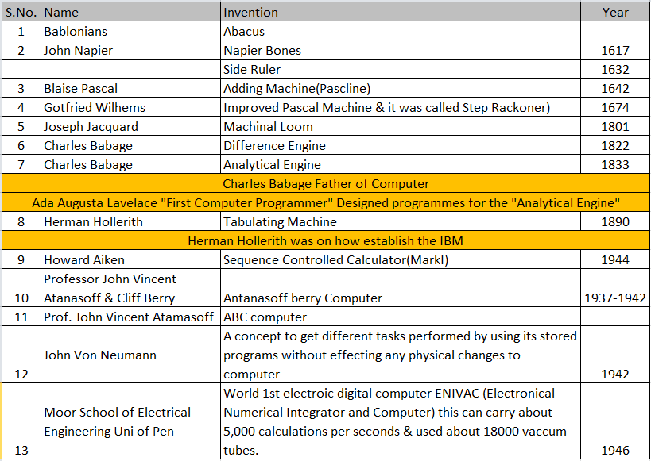
History of Computers

Slide 21
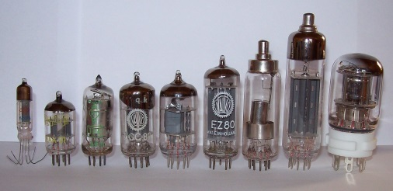
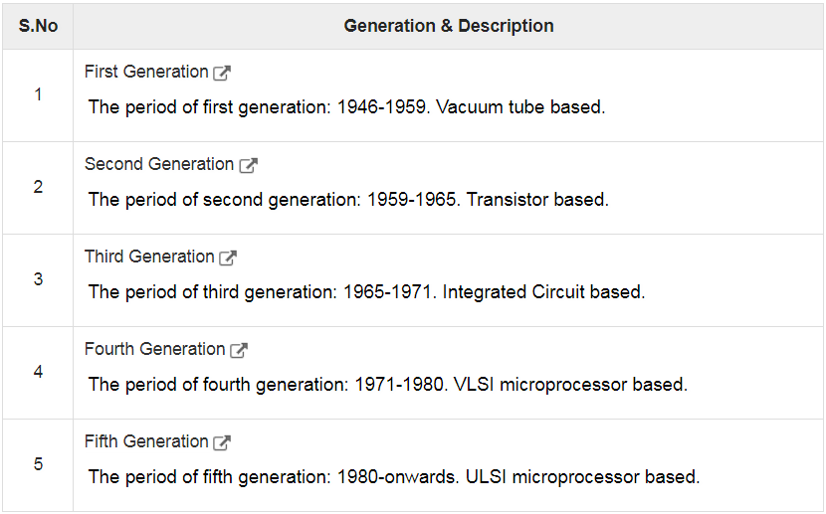
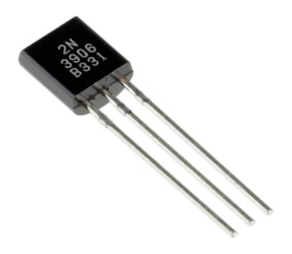
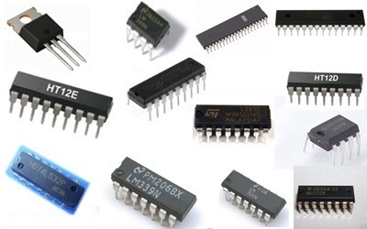
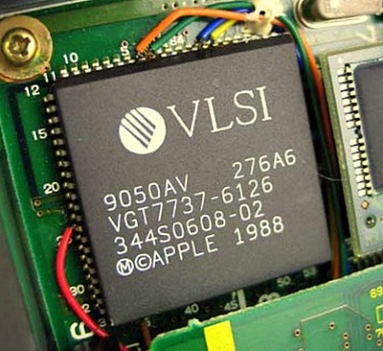
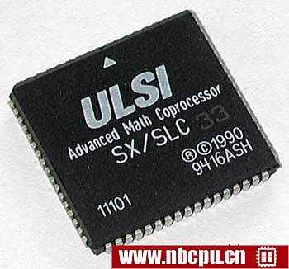
Computers Generations

Slide 22
FIRST GENERATION, 1951 – 1958: The Vacuum Tube
The first generation of computers, characterized by vacuum tubes, started in 1951 with the creation of –
UNIVAC (Universal Automatic Computer) – a tabulating machine which won the contest for the fastest machine which could count the US 1890 census.
VACUUM TUBES – electronic tubes about the size of light bulbs.
DISADVANTAGES:
They generate more heat causing many problems in temperature regulation and climate control.
Tubes were subject to frequent burn-out.

Slide 23
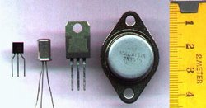
SECOND GENERATION, 1959 – 1964: The Transistor
The year 1959 marked the invention of transistors, which characterized the second generation of computers.
TRANSISTOR – was a three-legged component which shrunk the size of the first generation computers. Occupied only 1/100th of the space occupied by a vacuum tube
More reliable, had greater computational speed, required no warm-up time and consumed far less electricity.

Slide 24
THIRD GENERATION, 1965 – 1970: The Integrated Circuit
Third generation computers arose in 1965 with the invention of smaller electronic circuits called integrated circuits (IC’S)
INTEGRATED CIRCUITS – are square silicon chips containing circuitry that can perform the functions of hundreds of transistors.
ADVANTAGES:
RELIABILITY – Unlike vacuum tubes, silicon will not break down easily. It is very seldom that you will have to replace it.
LOW COST – Silicon chips are relatively cheap because of their small size and availability in the market. It also consumes less electricity.

Slide 25
FOURTH GENERATION, 1971 – 1980: VLS Microprocessor
Very-large-scale integration (VLSI) is the process of creating an integrated circuit (IC) by combining millions of transistors onto a single chip.
VLSI began in the 1970s when complex semiconductor and communication technologies were being developed. The microprocessor is a VLSI device. Before the introduction of VLSI technology, most ICs had a limited set of functions they could perform.
MICROPROCESSOR – is a silicon chip that contains the CPU – part of the computer where all processing takes place.
4004 chip – was the first microprocessor introduced by Intel Corporation.

Slide 26
FIFTH GENERATION, 1980-ownward: UVLS Microprocessor
Ultra large-scale integration (ULSI) is the process of integrating or embedding millions of transistors on a single silicon semiconductor microchip. ULSI technology was conceived during the late 1980s when superior computer processor microchips, specifically for the Intel 8086 series, were under development. ULSI is a successor to large-scale integration (LSI) and very large-scale integration (VLSI) technologies but is in the same category as VLSI.
Intel 486 and the Pentium series of processors were built on ULSI principles.

Slide 27
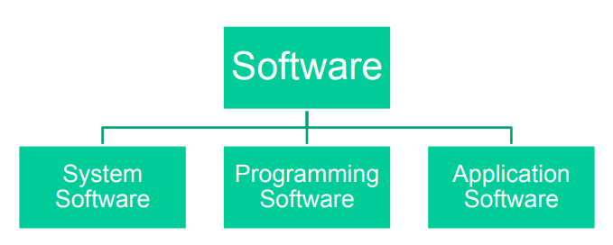
Software
Computer software, or just software, is a collection of computer programs and related data that provides the instructions for telling a computer what to do and how to do it.
Any set of instructions that guides the hardware and tells it how to accomplish each task.

Slide 28
System Software
System software is computer software designed to operate the computer hardware to provide basic functionality and to provide a platform for running application software.
Refers to the operating system and all utility programs that manage computer resources at a low level.

Slide 29
System Software Examples
Operating system like Windows etc
The BIOS (basic input/output system) gets the computer system started after you turn it on and manages the data flow between the operating system and attached devices such as the hard disk, video adapter, keyboard, mouse, and printer.
The boot program loads the operating system into the computer's main memory or random access memory (RAM).
System software also includes system utilities, such as the disk defragmenter and System Restore.

Slide 30
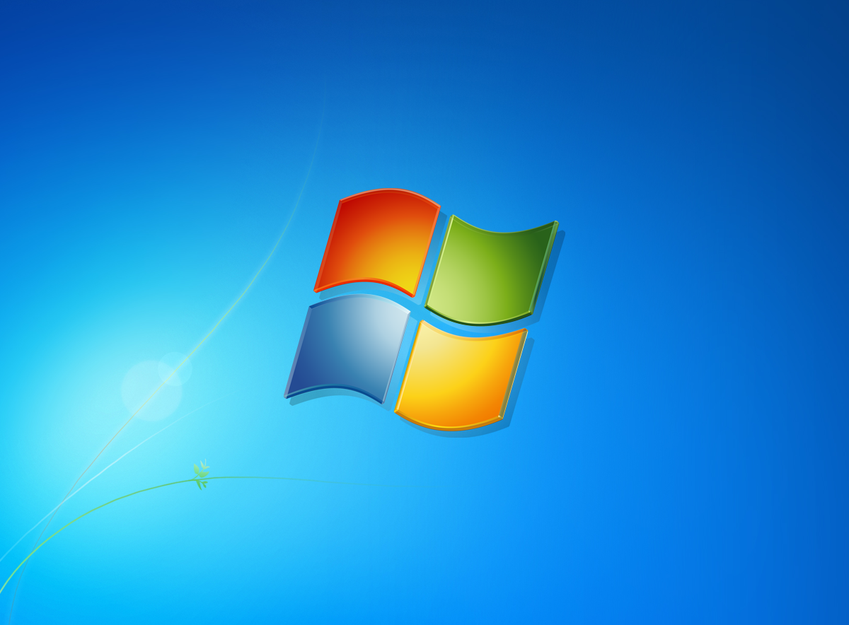
System Software Examples
Windows

Slide 31
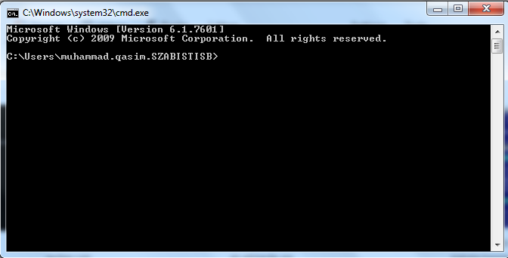
System Software Examples
DOS

Slide 32
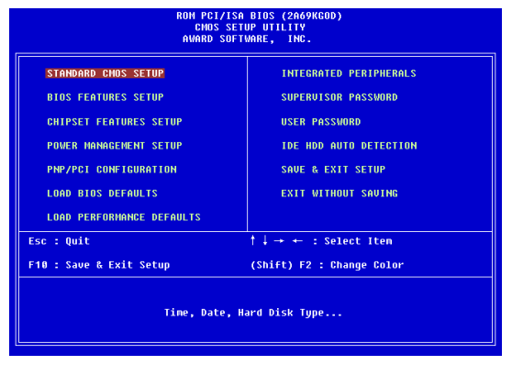
System Software Examples
BIOS

Slide 33
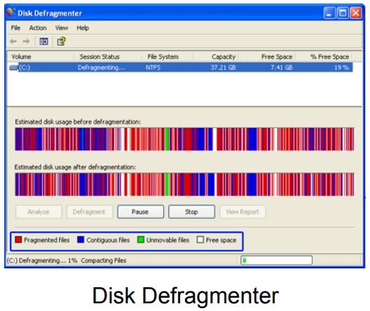
System Software Examples

Slide 34
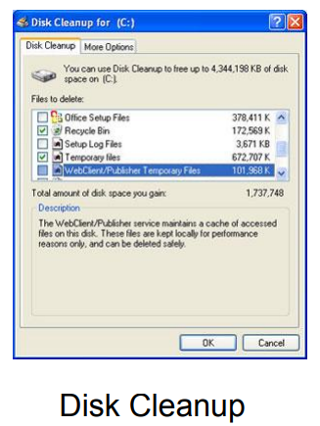
System Software Examples

Slide 35
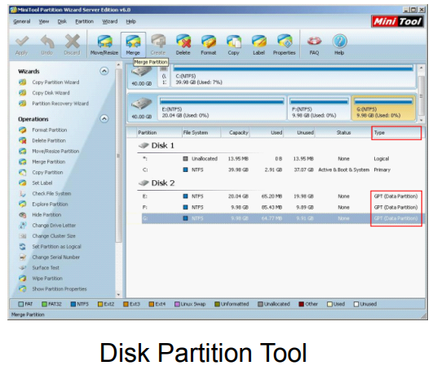
System Software Examples

Slide 36
Programming Software
Programming software include tools in the form of programs or applications that software developers use to create, debug, maintain, or otherwise support other programs and applications.
The term usually refers to relatively simple programs such as compilers, debuggers, interpreters, linkers, and text editors,
Example of programming language:
C, C++, C#, BASIC, JAVA, Visual Basic, Python, HTML, PHP

Slide 37
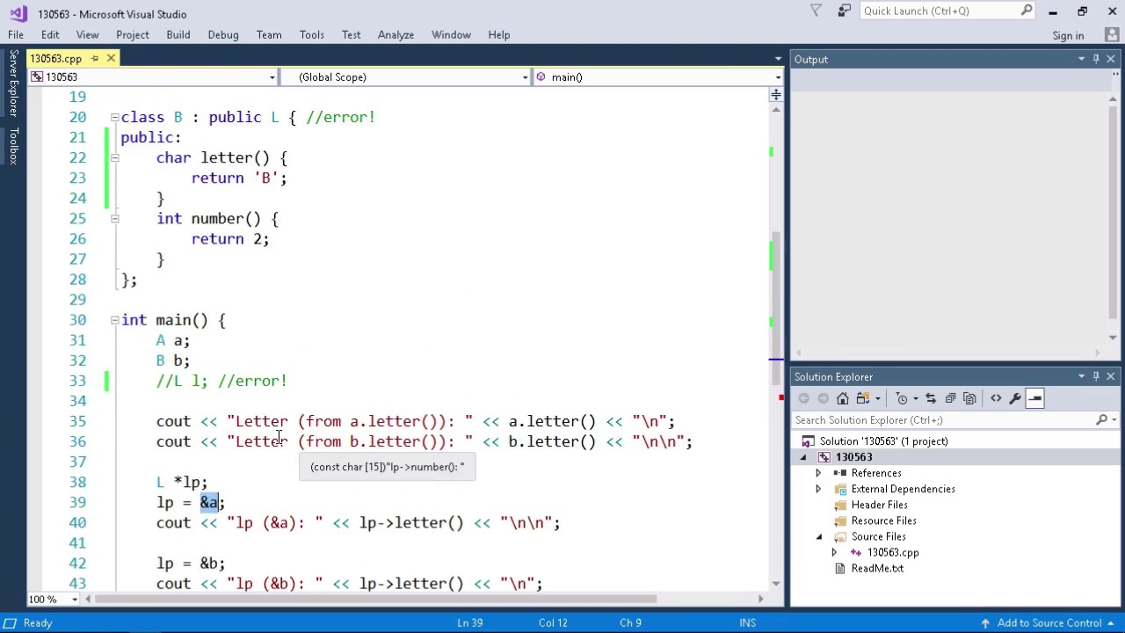
Programming Software
MS Visual Studio

Slide 38
Application Software
A program or group of programs designed for end users
Allows end users to accomplish one or more specific (non-computer related) tasks.

Slide 39
Application Software Examples
Examples of Computer Application Software
Word processor
Spreadsheet
Presentation Software
Database Management System
Desktop Publisher
Graphic Editor
Web Browser
:
Whatsapp
Facebook

Slide 40
Word Processor
Word processor is a software program capable of creating, storing, and printing documents.
Unlike the standard typewriter, users using word processors have the ability of creating a document and making any changes anywhere in the document.
This document can also be saved for modification at a later time or to be opened on any other computer using the same word processor.

Slide 41
Word Processor Features
Insert text
Delete text
Cut and paste
Copy
Page size and margins
Search and replace
Print

Slide 42
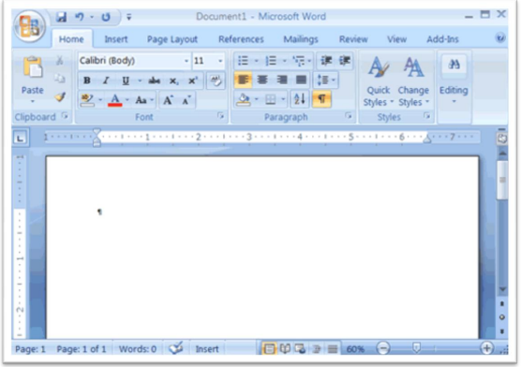
Word Processor Examples
Microsoft Word
WordPro
AppleWorks

Slide 43
Spread Sheet
Spreadsheet is a data file made up of rows and columns that are used to sort data and allow a user to manipulate and arrange data easily, commonly numerical data.
What makes a spreadsheet software program most unique is its ability to calculate values using mathematical formulas and the data in the cells.

Slide 44
Spread Sheet Features
Features:
Formulas
Functions
Charts
Cut/Copy/Paste with single cells or ranges of cells
Cells formatting
Cells merging

Slide 45
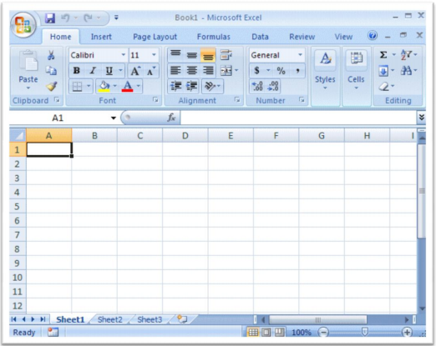
Spread Sheet Examples
Microsoft Excel
Lotus 1-2-3
Apple Numbers
OpenOffice Calc

Slide 46
Presentation
A presentation program is a software program that helps create a slideshow that addresses a topic.
Presentation programs are often used in businesses and schools for discussing a topic or for teaching.
It typically includes three major functions:
an editor that allows text to be inserted and formatted
a method for inserting and manipulating graphic images
a slide-show system to display the content.

Slide 47
Presentation Features
Insert Slide
Deletion of Inserted slides
Allows cut and paste slides in any order.
Allows duplication content or slide
Allows you to display the presentation designed in a slide show system. (View Slide Feature)
Allows animations and/or sounds manipulations on objects in the slide.

Slide 48
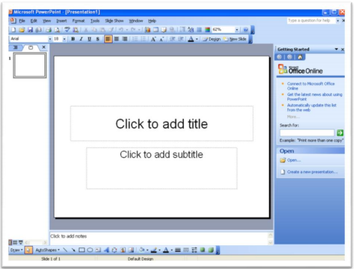
Presentation Examples
Microsoft PowerPoint
Adobe Persuasion
Hypercard
OpenOffice Impress
Scala Multimedia

Slide 49
Database Management (DMBS) Softwares
A program that controls the organization, storage, management, and retrieval of data in a database.
Users can create tables, queries, forms and reports.

Slide 50
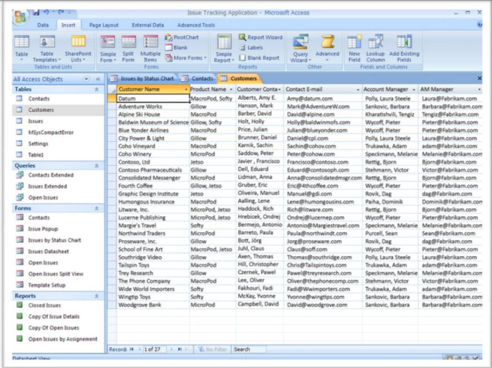
Database Management (DBMS) Softwares Examples
Microsoft Access
Oracle Database
MySQL
FoxPro

Slide 51
Desktop Publishing Softwares
Used to produce high-quality printed documents such as magazine, greeting card, posters, etc.
Allows you to use different typefaces, specify various margins and justifications, and embed illustrations and graphs directly into the text.

Slide 52
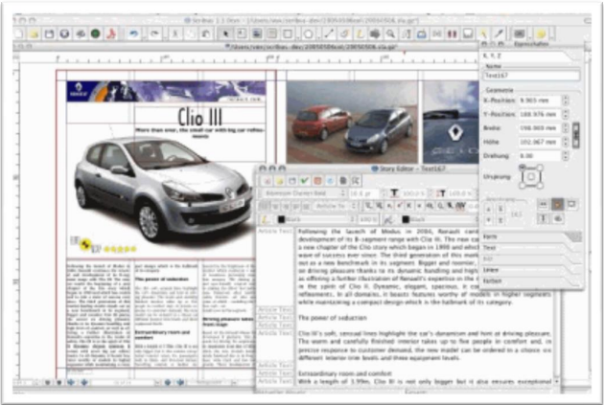
Desktop Publishing Softwares Examples
Adobe Indesign
QuarkXpress
MS Publisher

Slide 53
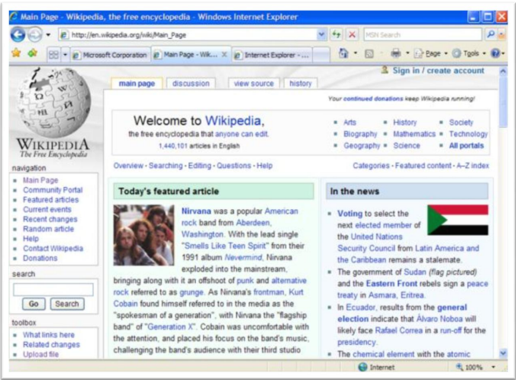
Web Browser
Web browser, a software application used to locate and display Web pages.
Example:
Internet Explore (IE)
Mozilla Firefox
Opera

Slide 54
Other Software
Graphics Software
Whatsapp
Facebook
Computer Aided Design (CAD)
Video Editor
Sound Editor
Video Games
Educational Software
Email Client
Electronic Media

Slide 55
Software Licencing
Is a legal instrument (by way of contract law) governing the usage or redistribution of software
Allowing an individual or group to use a piece of software
Nearly all applications are licensed
Some are based on the number machines on which the licensed program can run whereas others are based on the number of users that can use the program

Slide 56
Software Licencing
Types of Software License
Registerware: Refers to computer software which requires the user to give personal information through registration in order to download or use the program.
Shareware: Refers to copyrighted commercial software that is distributed without payment on a trial basis and is limited by any combination of functionality, availability, or convenience.
Freeware: Computer software that is available for use with no cost or for an optional fee. • Freeware is different from shareware, where the user is obliged to pay.
Open source: OSS is also a free software. OSS can be defined as computer software for which the human-readable source code is made available under a copyright license that meets the Open Source Definition. This permits users to use, change, and improve the software, and to redistribute it in modified or unmodified form.
Abandonware: It refers to software that is no longer available for purchase or that is at least a certain amount of years old.

Slide 57
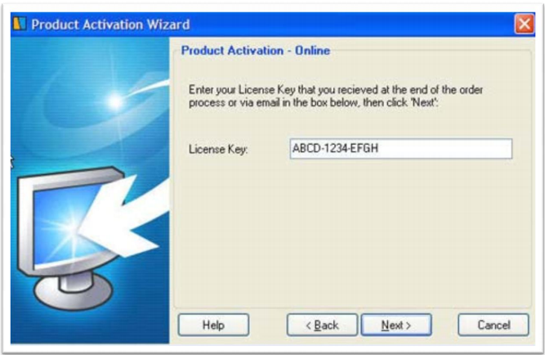
License Key
A software license key is a pattern of numbers and/or letters provided to licensed users of a software program.
License keys are typically created and delivered via a license generator once a software user has paid for the software and has agreed to the conditions of use and distribution as legally specified in the software license.

